Slide 1
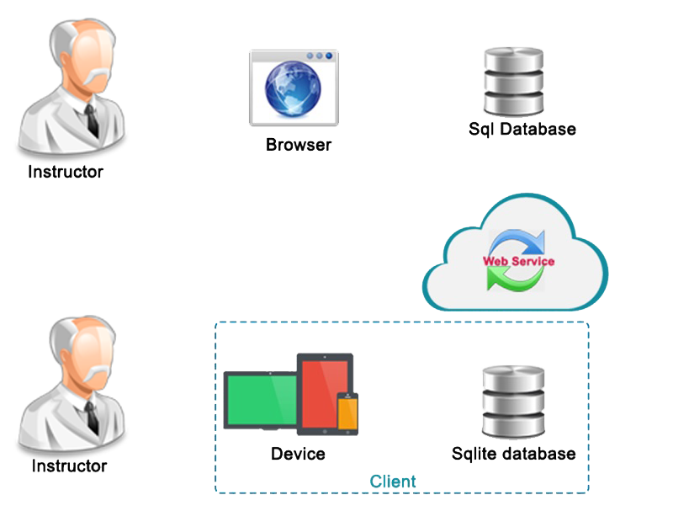



Process
3
5
Flow sql server
Flow sqlite
Using website
4
2
4
5
2
1
3
1
6

Slide 2
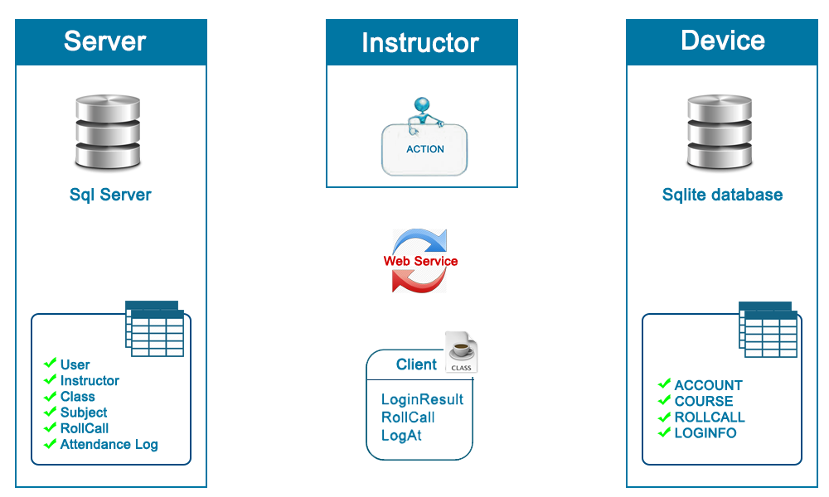
Managements data sync
Online mode
Offline mode
Sync database

Slide 3
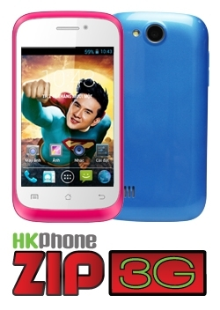
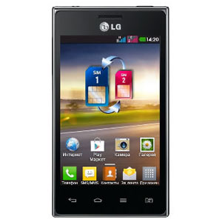
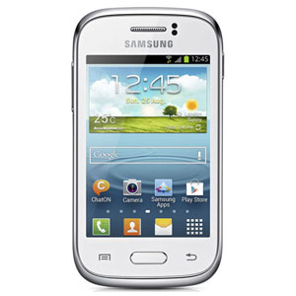
Product
LG Optimus L5 Dual E615
Samsung Galaxy Young S6310
Android: 4.2.2
Camera: 3MP
ROM: 512MP
LCD: 3.5”
Cost: 1.450.000đ
Android: 4.0.4 (ICS)
Camera: 5.0MP
ROM: 2.5GB
LCD: 4.0’’
Cost: 2.990.000₫
Android : 4.1.2(Jelly Bean)
Camera: 3.15MP
ROM: 4GB
LCD: 3.27’’
Cost: 2.990.000₫
http://www.thegioididong.com/dtdd?p=duoi-3-trieu http://hkphone.com.vn/product.html

